Slide 1
International Financial Accounting
Dr Sean Power, ACA

Slide 2
Session 3
Income statement

Slide 3
Session 3: Income statement
Introduction to income statement
Revenue (IFRS 15)
Share-based payments (IFRS 2)

Slide 4
Introduction to income statement

Slide 5
Recap: English terminology
The Income Statement
Revenues Sales Revenue Fee Revenue Interest Revenue Rent Revenue
Expenses Cost of Goods Sold Wages Expense Rent Expense Interest Expense Depreciation Expense Advertising Expense Insurance Expense Repair Expense Income Tax Expense
Notes:
These two lists contain typical revenue and expense account titles that we would likely find on the income statement.

Slide 6
AutoDesk & Ayden

Slide 7
Layout of income statement
Sales revenue
less
Cost of sales
equals
Gross profit
less
Operating expenses
equals
Operating profit
less
Interest expense
less
Tax expense
equals
Profit for the period

Slide 8
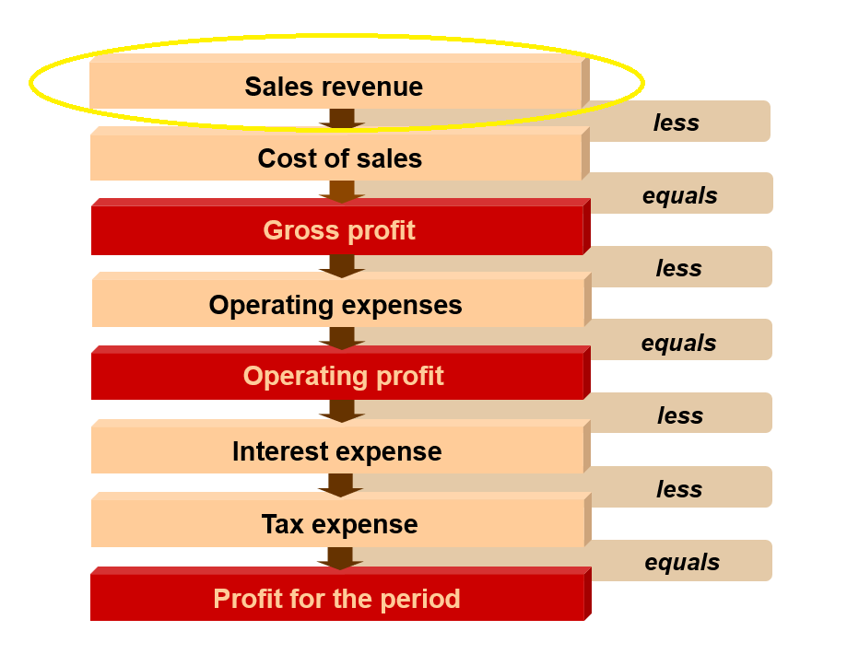
Revenue (the very important 1st line of income statement)

Slide 9
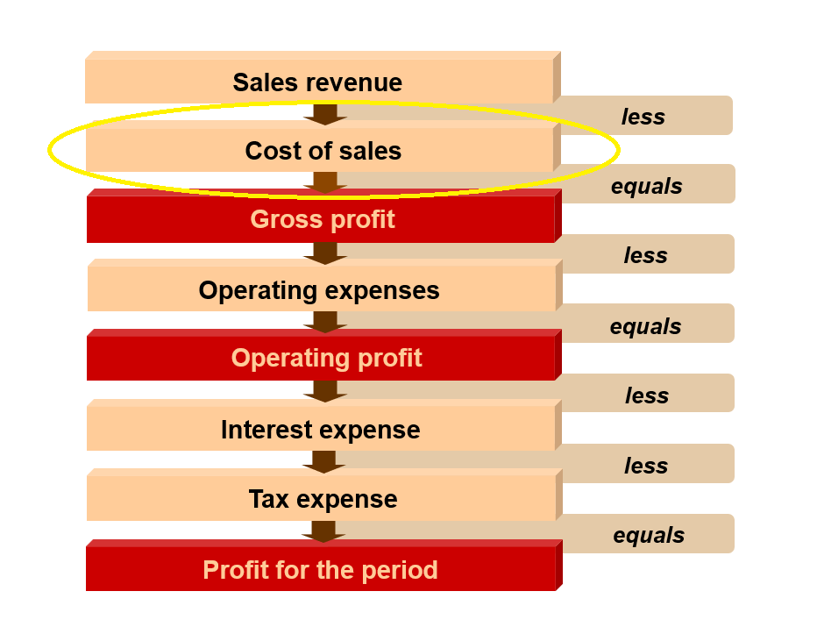
Cost of sales (2nd line of the income statement)

Slide 10
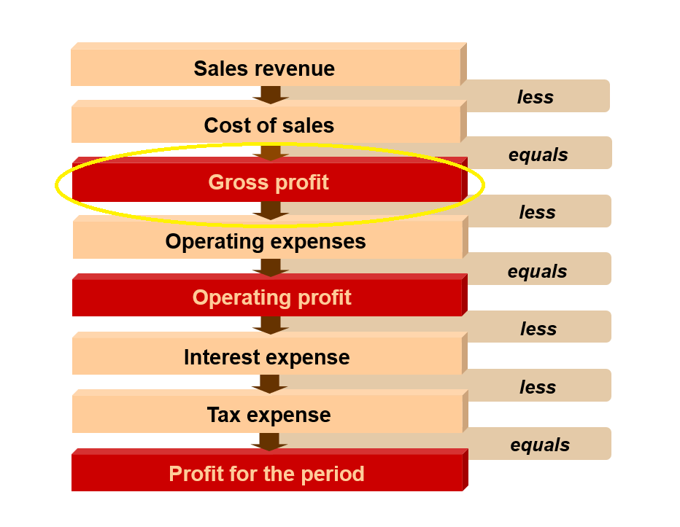
Gross profit

Slide 11
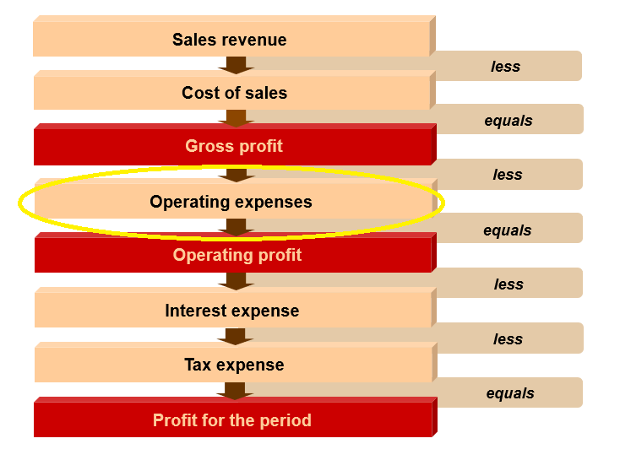
Operating expenses

Slide 12
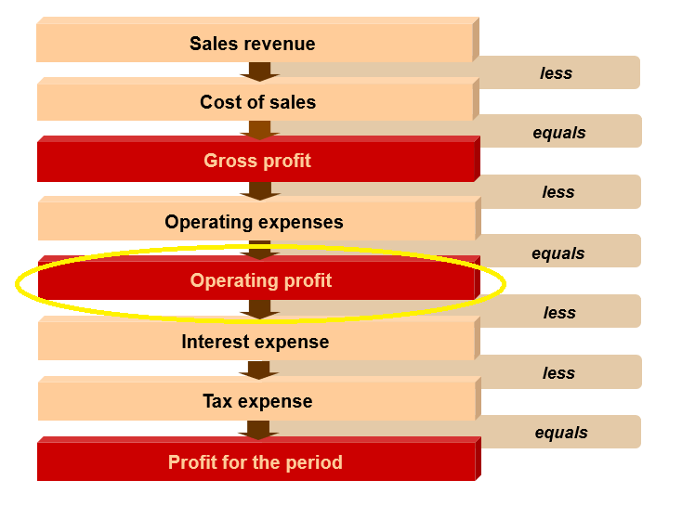

Operating profit

Slide 13
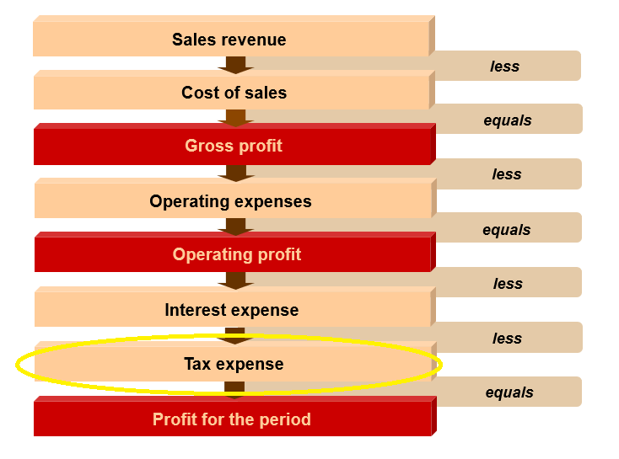

Tax expense

Slide 14
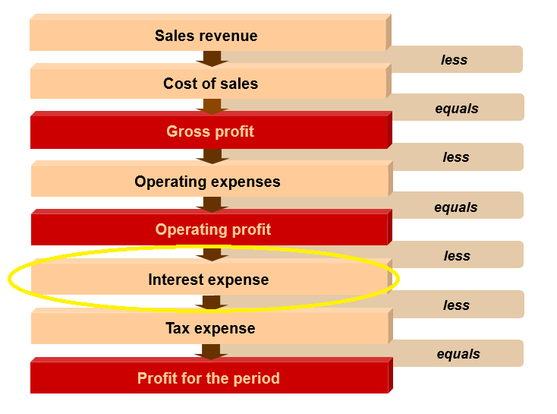

Interest expense

Slide 15
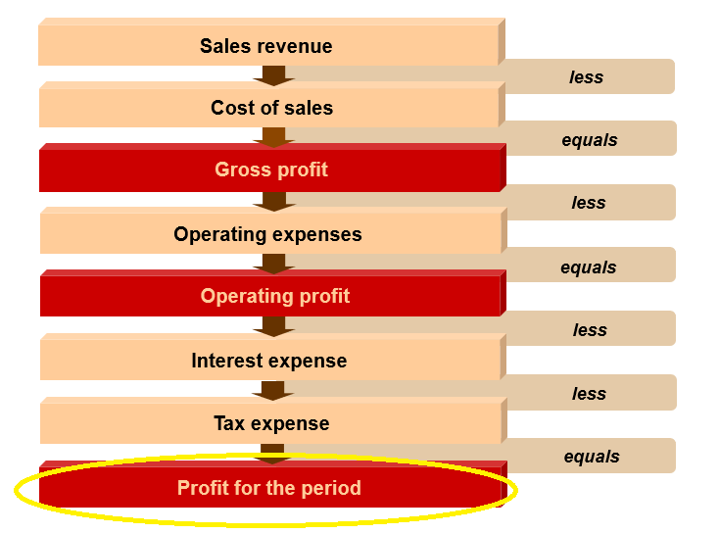

Net profit / “residual profit”

Slide 16
Revenue (IFRS 15)

Slide 17
Revenue (the very important 1st line of income statement)

Slide 18
Revenue & IFRS 15
IFRS 15: Establishes principles for reporting about nature, amount, timing & uncertainty of revenue & cash flows arising from contracts with customers
Standard was issued in May 2014 and became effective for all annual periods beginning on or after 1 Jan 2018 (earlier application permitted)

Slide 19
Reasons for issuing IFRS 15
Revenue is an important number for assessing financial performance
Sales revenue usually single largest figure reported in financial statements
Investors place significant weight on revenue when evaluating past performance & future prospects
Trend & growth rate in historical sales revenue drives many valuation models (e.g. free cash flow models)
Revenue recognition is also an area of financial reporting that has historically been susceptible to misstatement / fraud:
Revenue being recorded that is dependent on uncertain future events
Revenue being recorded before delivery completed
Contract revenue being recognised before services are performed
Fictitious sales agreements & documentation

Slide 20
Overview
IFRS 15 provides a single, comprehensive 5-step model to account for revenue
Core Principles:
Recognition: the entity shall recognise revenue to depict the transfer of control of goods or services to customers
Measurement: revenue shall be measured at the amount the entity expects to be entitled to in exchange for the goods or services transferred
IFRS 15 requires distinct goods or services to be accounted for separately.

Slide 21
5 step process to recognise revenue
Step 1: Identify the contract(s) with the customer [RECOGNITION]
‘Contract’ is an agreement between 2 or more parties that creates enforceable rights & obligations (in a legal sense)
Parties have approved contract & are committed to perform respective obligations → Can be oral, written or implied by business practices
Can identify each party’s rights regarding goods/services to be transferred
Can identify payment terms for goods/services to be transferred
Contract has commercial substance
It is probable the entity will collect consideration which it is entitled to in exchange of G/S

Slide 22
5 step process to recognise revenue
Step 2: Identify contract ‘performance obligations’ [RECOGNITION]
Part of contract is a promise to provide G/S
If G/S are DISTINCT, the promise is a ‘performance obligation’ & should be accounted for separately
G/S are DISTINCT if:
Customer can benefit from G/S on its own
Promise to provide those G/S is separately identifiable from other promises in the contract

Slide 23
5 step process to recognise revenue
Step 3: Determine the ‘Transaction Price’ [MEASUREMENT]
‘Transaction Price’: amount of consideration the entity expects to be entitled to in exchange for transferring promised goods/services (i.e. total contract consideration)
TP should be adjusted for the time value of money.
If the TP has a variable component: variable part only included in the TP if highly probable a significant reversal of revenue will not occur when the uncertainty is resolved

Slide 24
5 step process to recognise revenue
Step 4: Allocate ‘Transaction Price’ to ‘Performance Obligations’ in the contract [MEASUREMENT]
Normally done based on the relative stand-alone selling price of each distinct G/S promised in the contract
If the selling price is not observable – estimate it !

Slide 25
5 step process to recognise revenue
Step 5: Recognise revenue when the entity satisfies a ‘Performance Obligation’ [RECOGNITION]
Entity satisfies a performance obligation by transferring control of G/S to a customer (i.e. when customer obtains control of G/S)
Amount of revenue recognised is the amount allocated to the satisfied performance obligation
A performance obligation may be satisfied:
AT a point in time – typically with promised goods OR
OVER time – typically with promised services
If recognised OVER time: entity recognises the revenue by selecting an appropriate method for measuring progress toward the complete satisfaction of the performance obligation.
Notes:
NOTE: Goods/services are an asset (even if only momentarily in the case of services) when they are received and used.
You receive this asset as the service is delivered.

Slide 26
Question
When does ‘control’ of goods pass from buyer to seller?
A sandwich ?
A ship on the sea ?

Slide 27
Step 5: Let’s think about “performance” !
Goods & Services are an asset (even if only momentarily) when they are received & used
‘Control’: refers to the ability to direct the use of and obtain substantially all the benefits of the assets & to be able to protect/prevent the use of others in relation to those benefits
Factors that MAY indicate a transfer of control:
Point at which the entity is entitled to payment
Legal title transfers
Transfer of physical possession of an asset except for under consignment (where entity maintains control but not physical possession)
Transfer of risks & rewards of ownership
Customer has accepted the asset

Slide 28
Consignment Arrangements
When an entity delivers goods to another entity for sale to end customers, the entity should evaluate whether the other party has obtained CONTROL of the goods
If the other party has not obtained control of the goods:
Goods held in a consignment arrangement & should NOT recognise revenue upon delivery
Revenue should only be recognised when control is transferred to the customer
Indicators of a ‘consignment arrangement’:
Product controlled by entity until a specified event occurs (e.g. the final sale of the goods to the end customer) or until a specified period expires
The entity is able to require the return of the goods or transfer the goods to a third party
The dealer does not have an unconditional obligation to pay for the product (although it may be required to pay a deposit)

Slide 29
Warranties
Warranties are frequently included in arrangements to sell G/S whether explicitly stated or implied by the past business practices
2 types of warranty that should be accounted for differently:
(1) Service-type warranties and
(2) Assurance type warranties

Slide 30
1. Service-type warranty
Warranties that provide an additional service to the customer in addition to the assurance that the G/S is as specified in the contract
Indicators:
Customer has option to purchase warranty separately
Warranty provides a service beyond fixing defects which exist at time of sale
A service-type warranty is a distinct service and a separate performance obligation, therefore:
Using the estimated stand-alone selling price of the warranty, the entity must allocate a portion of the transaction price to the warranty
The allocated transaction price is recognised as revenue over the period that the warranty service is provided

Slide 31
(2) Assurance-type warranty
Warranties that promise customer that the delivered G/S is as specified in the contract
An assurance-type warranty does not provide an additional G/S to the customer
An assurance-type warranty is not a separate performance obligation - it is effectively a guarantee of quality
Assurance-type warranties are accounted for as warranty obligations under IAS 37 (Provisions, Contingent Liabilities & Contingent Assets)

Slide 32
Onerous Contracts
An onerous contract is where the unavoidable costs of meeting the obligations of a contract, exceed the economic benefits expected to be received under it
Accounted for under IAS 37 (Provisions, Contingent Liabilities & Contingent Assets)
Recognise a liability for expected losses on contract

Slide 33
Quiz
XCalc Ltd is a retailer which sells scientific calculators to schools
On the 21st December 2020, XCalc receives a written order from a school for scientific calculators with a total retail value of €20,000
The cost of the inventory of calculators necessary to fulfil the order is €15,000 to XCalc
Due to Christmas break, calculators not delivered until 3rd January 2021
The school paid for the order on 4th January 2021
How would the above sale be reflected in financial statements of Xcalc for financial year ended 31st December 2020?

Slide 34
Answer

Slide 35
Share-based payments (IFRS 2)

Slide 36
Equity Settled Share-Based Payment
‘Share based payment’ transaction occurs when the entity receives goods or services in return for:
Equity instruments OR
Incurring a liability
We only focus on one type of share-based payment → Equity settled share-based payment:
company issues own shares in exchange for goods and services

Slide 37
Scope of IFRS2
Concept of ‘share-based payment’ is broader than employee share options
IFRS 2 includes the issuance of share, or rights to shares, in exchange for goods and services
E.g.
Share appreciation rights
Employee share purchase plans
Issuance of shares (or rights to shares) may depend on market or non-market related conditions

Slide 38
Equity Settled Share-Based Payments
Entity receives goods or services in exchange for its own equity instruments (including shares or share options)
e.g. share option schemes offered to company employees
Typically schemes provide employees with the option of buying shares in the future at a pre-specified price
Goods + services received are measured at their fair value & recorded as an asset or expense
There is a corresponding increase in equity

Slide 39
Equity Settled Share-Based Payments
There are 3 important dates:
Date of grant – date at which employees are granted the option at a future point in time.
e.g. company on 1 Jan 2021 grants options to its directors to buy shares at €1.50 per share in the future
1 Jan 2021 is the date of grant of the options
Vesting date – this is the date on which director/employee qualifies for the option
e.g. the option agreement on 1 Jan 2021 might stipulate that directors have to complete 3 years of service (dating from 1/1/2021)
The vesting date of options would be 1/1/2024
Exercise date – this is the date that the directors/employees exercise their rights under the option agreement to purchase the shares

Slide 40
Equity Settled Share-Based Payments
Accounting treatment for ‘equity settled share-based payments’ is controversial topic !
Alves (2010) details the different arguments on whether or not ESSBP should be treated as an expense

Slide 41
Why shouldn’t share options be treated as an expense?
Does not meet the definition of an expense
CFW definition “expense”: expenses are decreases in assets, or increases in liabilities that result in decreases in equity other than those relating to distributions to holders of equity claims
Share options considered to be a capital transaction
The potential dilution of share options already reflected in the diluted EPS figure
The cost of share options cannot be estimated reliably
Expensing share options will damage young companies
Deteriorate their income statements
Make it difficult to raise money
Economic consequences for early/growth start-ups

Slide 42
Why should share options be treated as an expense?
Disclosure is not a substitute for recognition
Cost of share options can be measured reliably
Expensing share options will not significantly damage young companies
Investors comfortable with practice

Slide 43
IASB & IFRS 2 Position
Share options should be expensed
Share options regarded as payment in return for services provided by employees Cost of providing share options is expensed over the vesting period
Thereby, matching cost incurred with the benefits derived from the employee’s labour
Cost should be measured at the fair value of shares/share options at the date of grant of the options

Slide 44
Example 1
On 1 January 2021, M plc issued share options, giving each of four executives the right to purchase 25,000 shares at 25 cents a share. The value of the shares on 1 January 2021 was €1. A condition of the agreement was that the executive would complete three years of service from 1 January 2021. The nominal value of the company’s shares was 10 cents. It should be assumed that the fair value of each share option on 1 January 2021 equals 75 cents.
The company’s share price on subsequent dates:
1 January 2022 - €1.50 1 January 2023 - €2 1 January 2024 - €3
REQUIRED: Outline how the share options should be accounted for by M plc.

Slide 45
Example 1 Solution

Slide 46
What if share options lapse during the vesting period?
Overall effect of IFRS 2 is to expense the fair value (at grant date) of share options that vest
See Example 2

Slide 47
Example 2 Solution
If one of the executives in Example 1 were to leave on 1 Jan 2022, and therefore lose his/her share option rights, the following journals would be required:

Slide 48
Example 2 Solution …cont’d

Slide 49
What determines the fair value of the option at grant date?
IFRS 2 requires the fair value of equity instruments granted to be based on market prices, if possible
Terms + conditions of equity instruments should be taken into account when determining fair value
If market prices are not available, fair value should be estimated using a valuation technique to estimate price of equity instrument

Slide 50
IFRS 2 Questions

